Slide 1


Introduction to SQL Statements
SQL, or Structured Query Language, is the standard language for managing and manipulating relational databases. It provides a powerful set of statements that allow you to create, retrieve, update, and delete data with ease.

Slide 2
Data Definition Language (DDL)
1
DDL Statements
2
Key DDL Statements
3
Structural Changes
DDL statements are used to define and manage the structure of a database, including tables, indexes, and other objects.
The most common DDL statements are CREATE, ALTER, DROP, and TRUNCATE.
DDL statements allow you to make structural changes to your database, such as adding new tables, modifying existing tables, or removing unnecessary objects.

Slide 3
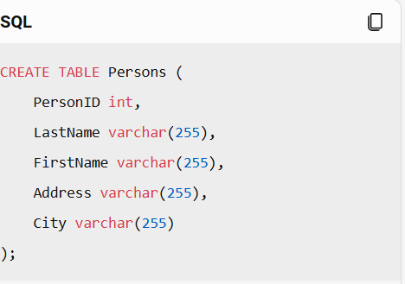

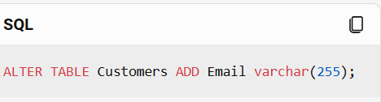
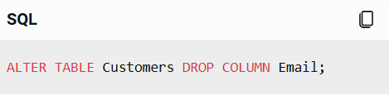
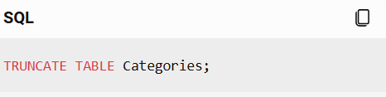
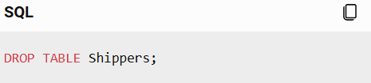
Data Definition Language (DDL)
CREATE
ALTER
The CREATE statement is used to define and build new database objects, such as tables, indexes, and views.
The ALTER statement is used to modify the structure of an existing database object, such as adding, removing, or changing columns in a table.
DROP
TRUNCATE
The DROP statement is used to remove an existing database object, such as a table or index, from the database.
The TRUNCATE statement is used to remove all data from a table, while keeping the table structure intact.

Slide 4
Data Definition Language (DDL)
Example: Creating a New Table
Table Structure
Primary Key
This creates a new table called "Customers" with five columns: CustomerID, FirstName, LastName, Email, and Phone.
The CustomerID column is defined as the primary key, which ensures unique identification of each customer record.
To create a new table for customer information, you can use the CREATE TABLE statement:
CREATE TABLE Customers ( CustomerID INT PRIMARY KEY, FirstName VARCHAR(50), LastName VARCHAR(50), Email VARCHAR(100), Phone VARCHAR(20) );

Slide 5
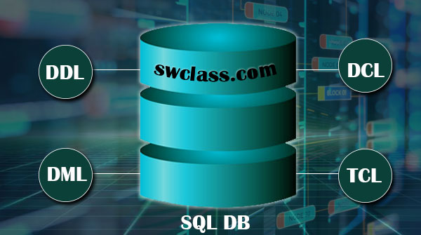
Data Query Language (DQL)
1
DQL Statements
2
Key DQL Statements
DQL statements are used to retrieve and query data from a database, allowing you to filter, sort, and aggregate information.
The most common DQL statement is SELECT, which is used to retrieve data from one or more tables.
3
Powerful Querying
DQL statements provide powerful ways to filter, sort, and group data, making it easier to find the information you need.

Slide 6
Data Query Language (DQL)
SELECT Statement
Filtering with WHERE
Sorting with ORDER BY
The SELECT statement is used to retrieve data from a database. It allows you to specify the columns you want to retrieve and the conditions for the data you want to retrieve.
The WHERE clause in a SELECT statement allows you to filter the results based on specific criteria, such as selecting only customers with a specific email domain.
The ORDER BY clause in a SELECT statement allows you to sort the results in ascending or descending order based on one or more columns.

Slide 7
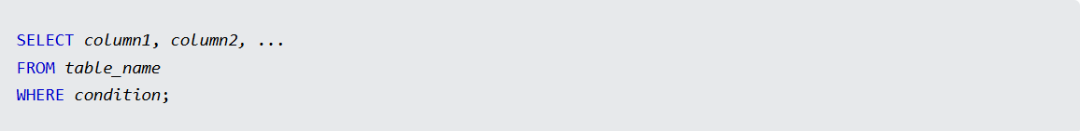
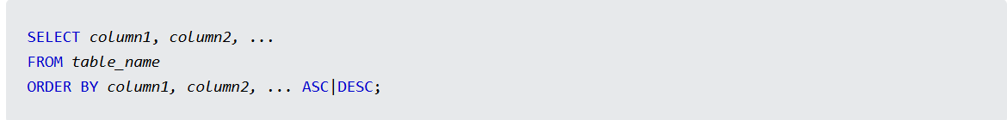
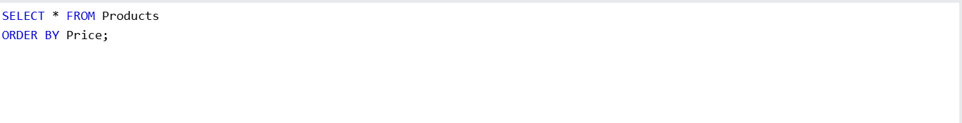

Slide 8

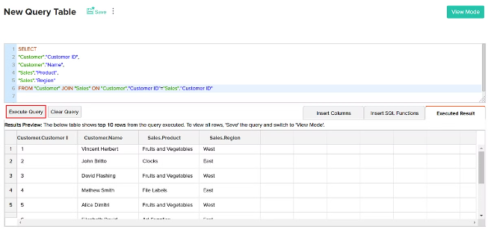
Data Query Language (DQL)
1
Example: Retrieving Customer Information
To retrieve customer information based on specific criteria, you can use a SELECT statement like this:
2
Query
SELECT FirstName, LastName, Email, Phone FROM Customers WHERE Email LIKE '%@example.com';
3
Results
This query will return the first name, last name, email, and phone number of all customers with an email address that ends with '@example.com'.

Slide 9
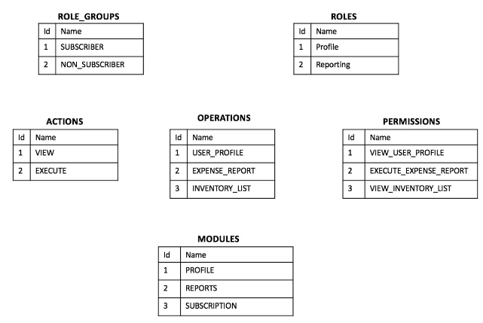
Data Control Language (DCL)
Using the 'GRANT' Statement
The 'GRANT' statement is used to give user's permissions to a database. The syntax for the 'GRANT' statement is:
SYNTAX
GRANT privilege_name ON object_name TO {user_name |PUBLIC |role_name} [WITH GRANT OPTION];
Let's consider an example:
GRANT SELECT, INSERT, DELETE ON my db TO 'user1'@'localhost';
Using the 'REVOKE' Statement
The 'REVOKE' statement is used to take back permissions from a user. The syntax for the 'REVOKE' statement is:
REVOKE privilege_name ON object_name FROM {user_name |PUBLIC |role_name}
Here is an example:
REVOKE INSERT ON mydb FROM 'user1'@'localhost';
This command revokes the INSERT permission on the database 'mydb' from 'user1'.

Slide 10


Data Manipulation Language (DML)
1
DML Statements
2
Key DML Statements
DML statements are used to create, modify, and delete data in a database, allowing you to manage the actual content of your database.
The most common DML statements are INSERT, UPDATE, and DELETE.
3
Data Management
DML statements provide the tools to add new data, update existing data, and remove data from your database as needed.

Slide 11


INSERT INTO Customers (CustomerName, ContactName, Address, City, PostalCode, Country) VALUES ('Cardinal', 'Tom B. Erichsen', 'Skagen 21', 'Stavanger', '4006', 'Norway');
Data Manipulation Language (DML)
INSERT
UPDATE
The INSERT statement is used to add new data to a table, such as inserting a new customer record.
The UPDATE statement is used to modify existing data in a table, such as updating a customer's email address or phone number.
DELETE
UPDATE Customers SET ContactName = 'Alfred Schmidt', City= 'Frankfurt' WHERE CustomerID = 1;
The DELETE statement is used to remove data from a table, such as removing a customer record that is no longer needed.
DELETE FROM Customers WHERE CustomerName='Alfreds Futterkiste';

Slide 12


Data Manipulation Language (DML)
1
Example: Adding a New Customer
To add a new customer to the Customers table, you can use the INSERT statement:
2
Updating Customer Information
To update an existing customer's information, you can use the UPDATE statement:
3
Deleting a Customer
To remove a customer from the Customers table, you can use the DELETE statement:

Slide 13
Transaction Control Language (TCL)
ROLLBACK
Rollback command This command restores the database to last commited state.
It is also used with SAVEPOINT command to jump to a save point in an ongoing transaction.
If we have used the UPDATE command to make some changes into the database, and realise that those changes were not required, then we can use
the ROLLBACK command to rollback those changes, if they were not commited using the COMMIT command.
Following is rollback command's syntax,
COMMIT
COMMIT command is used to permanently save any transaction into the database.
When we use any DML command like INSERT, UPDATE or DELETE, the changes made by these commands are not permanent,
until the current session is closed, the changes made by these commands can be rolled back.
To avoid that, we use the COMMIT command to mark the changes as permanent.
Following is commit command's syntax,

Slide 14
Transaction Control Language (TCL)
SAVEPOINT
SAVEPOINT command is used to temporarily save a transaction so that you can rollback to that point whenever required.
Following is savepoint command's syntax,
SAVEPOINT savepoint_name;..
In short, using this command we can name the different states of our data in any table and then rollback to that state using
the ROLLBACK command whenever required.

Slide 15
RELATIONAL ALGEBRA
Relational algebra is a procedural query language that works on relational model. The purpose of a query language is to retrieve data from database or perform various operations such as insert, update, delete on the data. When I say that relational algebra is a procedural query language, it means that it tells what data to be retrieved and how to be retrieved.
On the other hand relational calculus is a non-procedural query language, which means it tells what data to be retrieved but doesn’t tell how to retrieve it. We will discuss relational calculus in a separate tutorial.

Slide 16
RELATIONAL ALGEBRA
Types of operations in relational algebra We have divided these operations in two categories:
1. Basic Operations 2. Derived Operations
Basic/Fundamental Operations:
1. Select (σ)
2. Project (∏)
3. Union (∪)
4.Intersection Operator (∩)
5. Set Difference (-)
6. Cartesian product (X)
7. Rename (ρ)

Slide 17
RELATIONAL ALGEBRA
Types of operations in relational algebra We have divided these operations in two categories:
1. Basic Operations 2. Derived Operations
Derived Operations:
1. Natural Join (⋈)
2. Left, Right, Full outer join ( , , )
3. Intersection (∩)
4. Division (÷)

Slide 18
RELATIONAL ALGEBRA
Select Operator is denoted by sigma (σ) and it is used to find the tuples (or rows) in a relation (or table) which satisfy the given condition.
If you understand little bit of SQL then you can think of it as a where clause in SQL, which is used for the same purpose.
Syntax of Select Operator (σ)
σ Condition/Predicate(Relation/Table name)

Slide 19
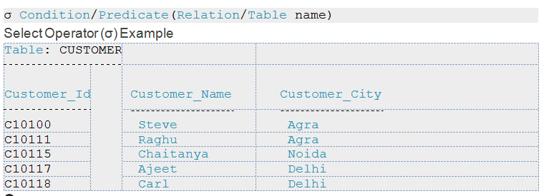
RELATIONAL ALGEBRA
Select Operator is denoted by sigma (σ) and it is used to find the

Slide 20
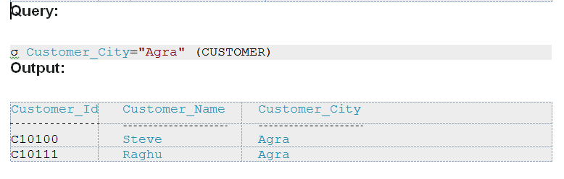
RELATIONAL ALGEBRA
Select Operator is denoted by sigma (σ) and it is used to find the

Slide 21
RELATIONAL ALGEBRA
Select Operator is denoted by sigma (σ) and it is used to find the
In general, we allow comparisons using =, >,< , ≥ in the selection predicate. Furthermore, we can combine several predicates into a larger predicate by using the connectives and (∧), or (∨), and not (¬).
σbranch-name = “Perryridge” ∧ amount>1200 (loan)

Slide 22
RELATIONAL ALGEBRA
Project Operator (∏)
Project operator is denoted by ∏ symbol and it is used to select desired columns (or attributes) from a table (or relation).
Project operator in relational algebra is similar to the Select statement in SQL.
Syntax of Project Operator (∏)
∏ column_name1, column_name2, ...., column_nameN(table_name)
Project Operator (∏) Example
In this example, we have a table CUSTOMER with three columns, we want to fetch only two columns of the table, which we can do with the help of Project Operator ∏.

Slide 23
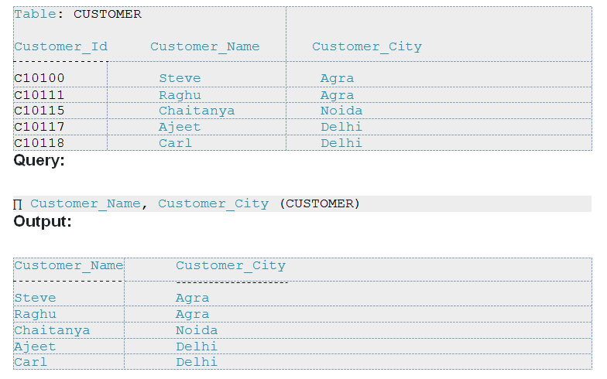
RELATIONAL ALGEBRA

Slide 24
RELATIONAL ALGEBRA
Union Operator ( )
Union operator is denoted by ∪ symbol and it is used to select all the rows (tuples) from two tables (relations).
Lets discuss union operator a bit more. Lets say we have two relations R1 and R2 both have same columns and we want to select all the tuples(rows) from these relations then we can apply the union operator on these relations.
Note: The rows (tuples) that are present in both the tables will only appear once in the union set. In short you can say that there are no duplicates present after the union operation.
Syntax of Union Operator ( )
table_name1 ∪ table_name2

Slide 25
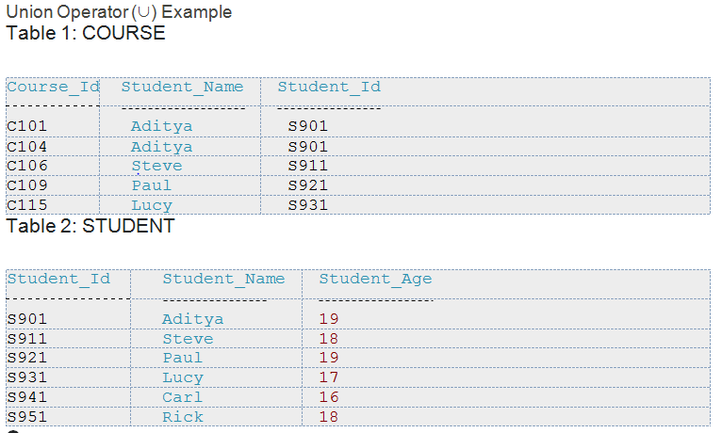
RELATIONAL ALGEBRA

Slide 26
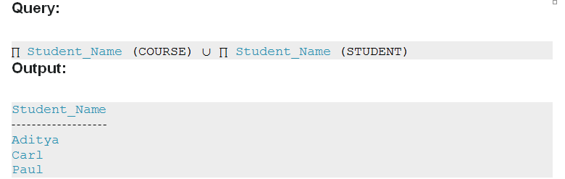
RELATIONAL ALGEBRA

Slide 27
RELATIONAL ALGEBRA
Intersection Operator (∩)
Intersection operator is denoted by ∩ symbol and it is used to select common rows (tuples) from two tables (relations).
Lets say we have two relations R1 and R2 both have same columns and we want to select all those tuples(rows) that are present in both the relations, then in that case we can apply intersection operation on these two relations R1 ∩ R2.
Note: Only those rows that are present in both the tables will appear in the result set.
Syntax of Intersection Operator (∩)
table_name1 ∩ table_name2

Slide 28
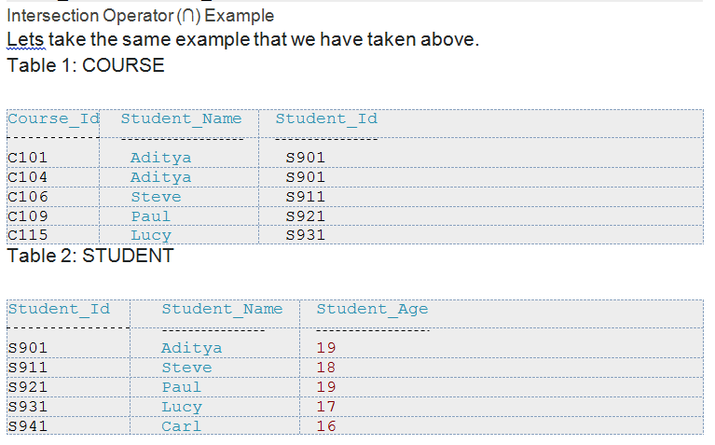
RELATIONAL ALGEBRA

Slide 29
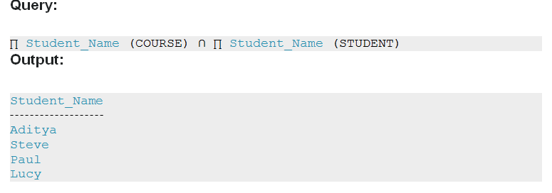
RELATIONAL ALGEBRA

Slide 30
RELATIONAL ALGEBRA
Set Difference (-)
Set Difference is denoted by – symbol. Lets say we have two relations R1 and R2
and we want to select all those tuples(rows) that are present in Relation R1 but
not present in Relation R2, this can be done using Set difference R1 – R2.
Syntax of Set Difference (-)
table_name1 - table_name2
Set Difference (-) Example
Lets take the same tables COURSE and STUDENT that we have seen above.

Slide 31
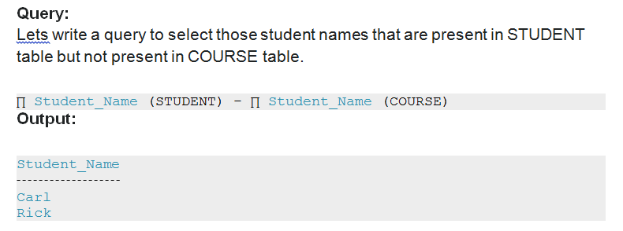
RELATIONAL ALGEBRA

Slide 32
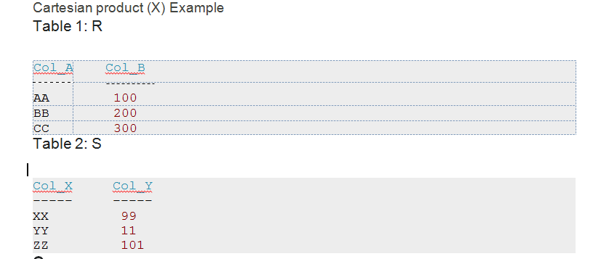
RELATIONAL ALGEBRA
Cartesian product (X)
Cartesian Product is denoted by X symbol. Lets say we have two relations R1 and R2 then the cartesian product of these two relations (R1 X R2) would combine each tuple of first relation R1 with the each tuple of second relation R2. Lets take an example of this, you will be able to understand this.
Syntax of Cartesian product (X)
R1 X R2

Slide 33
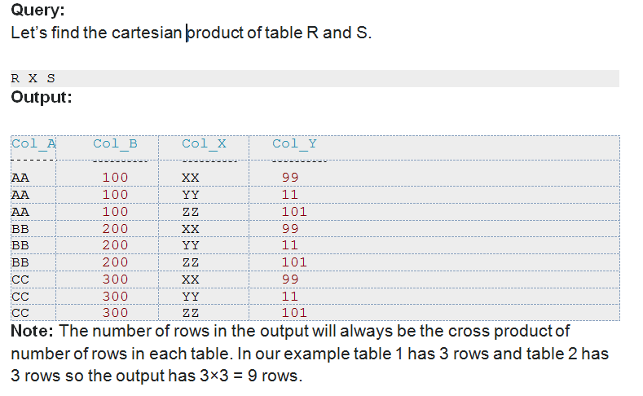
RELATIONAL ALGEBRA

Slide 34
RELATIONAL ALGEBRA
Rename (ρ)
Rename (ρ) operation can be used to rename a relation or an attribute of a relation.
Rename (ρ) Syntax:
ρ(new_relation_name, old_relation_name)
Rename (ρ) Example
Lets say we have a table customer, we are fetching customer names and we are renaming
the resulted relation to CUST_NAMES.
Table: CUSTOMER

Slide 35
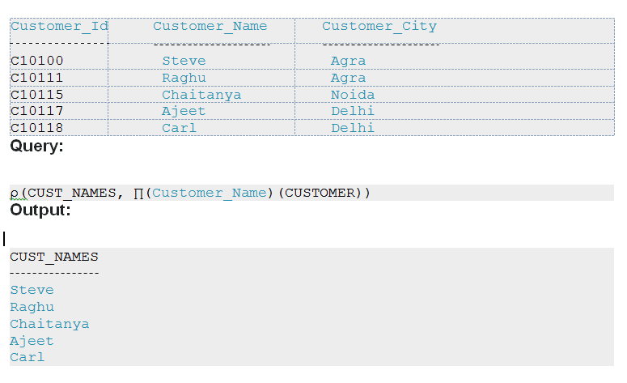
RELATIONAL ALGEBRA

Slide 36
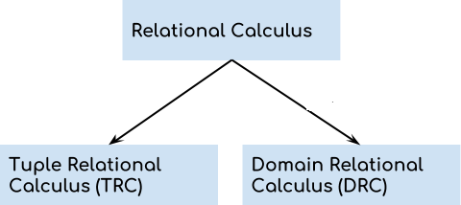
RELATIONAL CALCULUS
Relational calculus is a non-procedural query language that tells the system what data to be retrieved but doesn’t tell how to retrieve it.
Types of Relational Calculus

Slide 37
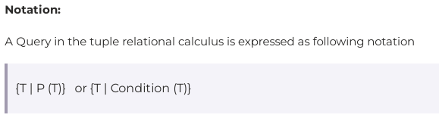
RELATIONAL CALCULUS
Tuple Relational Calculus (TRC)
Tuple relational calculus is used for selecting those tuples that satisfy the given condition.
T is the resulting tuples
P(T) is the condition used to fetch T.

Slide 38
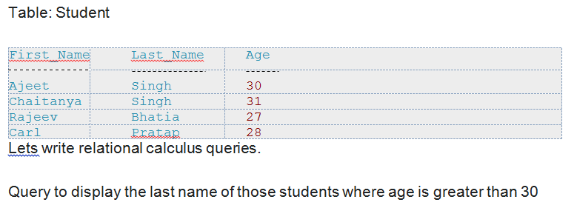
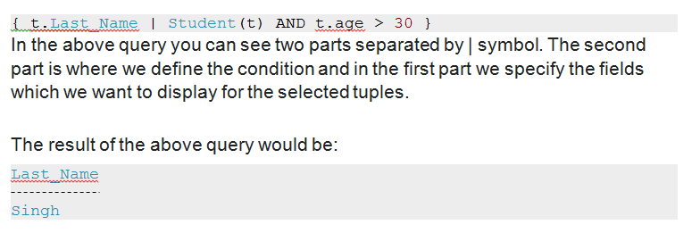
RELATIONAL CALCULUS

Slide 39
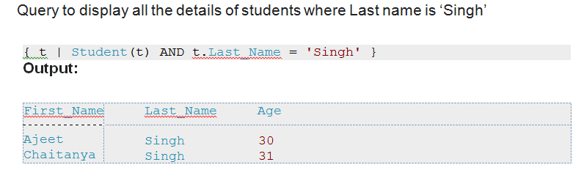
RELATIONAL CALCULUS

Slide 40
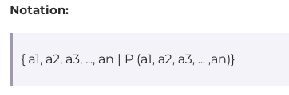
RELATIONAL CALCULUS
Domain Relational Calculus (DRC)
In domain relational calculus the records are filtered based on the domains. Again we take the same table to understand how DRC works.
Many of the calculus expressions involves the use of Quantifiers.
There are two types of quantifiers:
Universal Quantifiers: The universal quantifier denoted by ∀ is read as for all which means that in a given set of tuples exactly all tuples satisfy a given condition.
Existential Quantifiers: The existential quantifier denoted by ∃ is read as for all which means that in a given set of tuples there is at least one occurrences whose value satisfy a given condition.

Slide 41
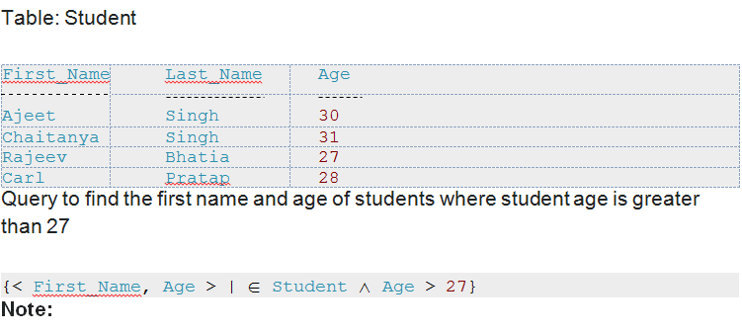
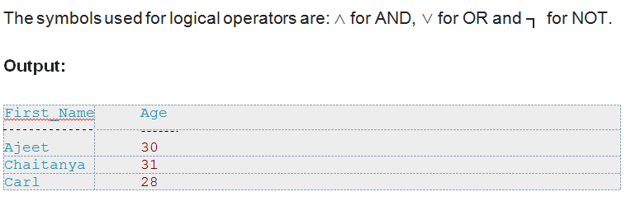
RELATIONAL CALCULUS

Slide 42
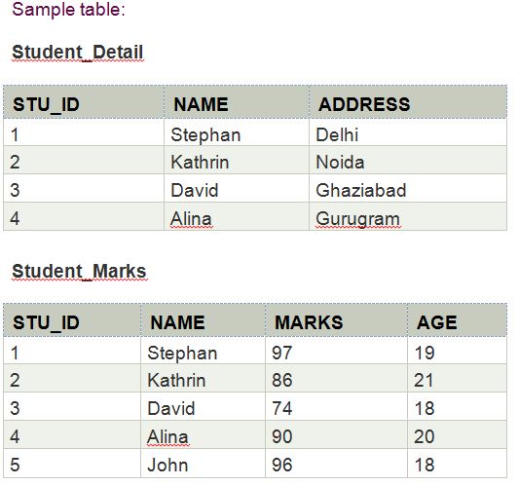
VIEWS IN DBMS
Views in SQL are a type of virtual table that simplifies how users interact with data across one or more tables. Unlike traditional tables, a view in SQL does not store data on disk; instead, it dynamically retrieves data based on a pre-defined query each time it’s accessed.
SQL views are particularly useful for managing complex queries, enhancing security, and presenting data in a simplified format.
Views in SQL are considered as a virtual table. A view also contains rows and columns.
To create the view, we can select the fields from one or more tables present in the database.
A view can either have specific rows based on certain condition or all the rows of a table.

Slide 43
VIEWS IN DBMS
1. Creating view
A view can be created using the CREATE VIEW statement. We can create a view from a single table or multiple tables.
Syntax:
CREATE VIEW view_name AS
SELECT column1, column2.....
FROM table_name
WHERE condition;
2. Creating View from a single table
In this example, we create a View named DetailsView from the table Student_Detail.
Query:
CREATE VIEW DetailsView AS
SELECT NAME, ADDRESS
FROM Student_Details
WHERE STU_ID < 4;

Slide 44
VIEWS IN DBMS
SELECT * FROM DetailsView;
Output:
3. Creating View from multiple tables
View from multiple tables can be created by simply include multiple tables in the SELECT statement.
In the given example, a view is created named MarksView from two tables Student_Detail and Student_Marks.
Query:
CREATE VIEW MarksView AS
SELECT Student_Detail.NAME, Student_Detail.ADDRESS, Student_Marks.MARKS
FROM Student_Detail, Student_Mark
WHERE Student_Detail.NAME = Student_Marks.NAME; To display
NAME | ADDRESS
Stephan | Delhi
Kathrin | Noida
David | Ghaziabad

Slide 45
VIEWS IN DBMS
SELECT * FROM MarksView;
4. Deleting View
A view can be deleted using the Drop View statement.
Syntax
DROP VIEW view_name;
Example:
If we want to delete the View MarksView, we can do this as: DROP VIEW MarksView;
NAME | ADDRESS | MARKS
Stephan | Delhi | 97
Kathrin | Noida | 86
David | Ghaziabad | 74
Alina | Gurugram | 90

Slide 46
NO-SQL
NoSQL stands for "not only SQL" and refers to a type of database that stores data in a non-tabular format. NoSQL databases are designed to handle large amounts of unstructured data, such as documents, graphs, key-value, and wide columns.
NoSQL databases are increasingly used in big data and real-time web applications.
simplicity of design, simpler "horizontal" scaling to clusters of machines (which is a problem for relational databases), finer control over availability and limiting the object-relational impedance mismatch.
Types of NoSQL databases
The data structures used by NoSQL databases (e.g. key–value pair, wide column, graph, or document) are different from those used by default in relational databases, making some operations faster in NoSQL.
Key-value Key-value stores pair keys and values using a hash table. Key- value types are best when a key is known and the associated value for the key is unknown.

Slide 47
NO-SQL
Document databases store data in documents similar to JSON (JavaScript Object Notation) objects. Each document contains pairs of fields and values. The values can typically be a variety of types including things like strings, numbers, Booleans, arrays, or objects.
Document databases extend the concept of the key-value database by organising entire documents into groups called collections. They support nested key-value pairs and allow queries on any attribute within a document.
Wide-column stores store data in tables, rows, and dynamic columns.
Columnar, wide-column or column-family databases efficiently store data and query across rows of sparse data and are advantageous when querying across specific columns in the database.
Graph databases store data in nodes and edges. Nodes typically store information about people, places, and things, while edges store information about the relationships between the nodes.
Graph databases use a model based on nodes and edges to represent interconnected data—such as relationships between people in a social network—and offer simplified storage and navigation through complex relationships

Slide 48
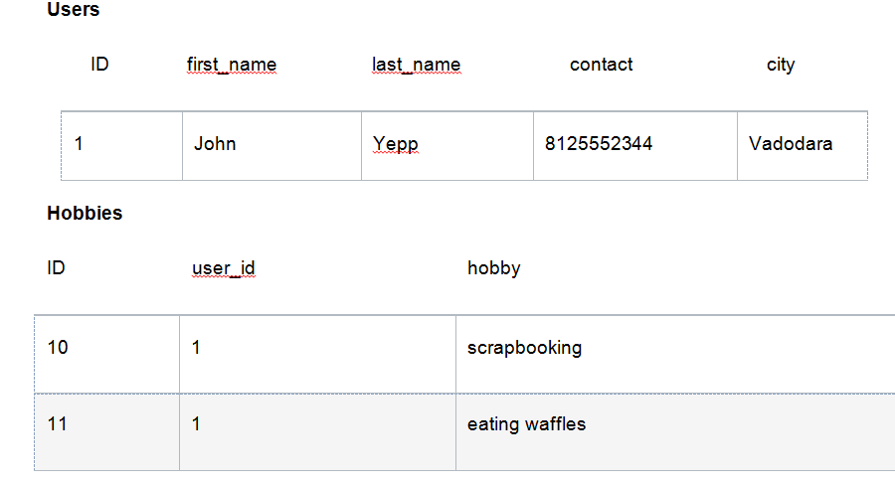
NO-SQL
RDBMS vs NoSQL: Data Modeling Example
Let's consider an example of storing information about a user and their hobbies. We need to store a user's first name, last name, cell phone number, city, and hobbies.
In a relational database, we'd likely create two tables: one for Users and one for Hobbies.

Slide 49
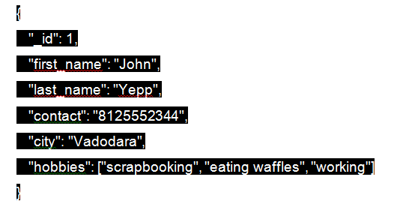
NO-SQL
In order to retrieve all of the information about a user and their hobbies, information from the Users table and Hobbies table will need to be joined together.
The data model we design for a NoSQL database will depend on the type of NoSQL database we choose. Let's consider how to store the same information about a user and their hobbies in a document database like MongoDB.

Slide 50
NO-SQL
In order to retrieve all of the information about a user and their hobbies, a single document can be retrieved from the database. No joins are required, resulting in faster queries.
Advantages of NoSQL:
There are many advantages of working with NoSQL databases such as MongoDB and Cassandra. The main advantages are high scalability and high availability.
High scalability –
NoSQL database use sharding for horizontal scaling. Partitioning of data and placing it on multiple machines in such a way that the order of the data is preserved is sharding. Vertical scaling means adding more resources to the existing machine whereas horizontal scaling means adding more machines to handle the data. Vertical scaling is not that easy to implement but horizontal scaling is easy to implement.
Examples of horizontal scaling databases are MongoDB, Cassandra etc. NoSQL canhandle huge amount of data because of scalability, as the data grows NoSQL scale itself to handle that data in efficient manner.
High availability –
Auto replication feature in NoSQL databases makes it highly available because in case of any failure data replicates itself to the previous consistent state.

Slide 51
NO-SQL
When should NoSQL be used:
When huge amount of data need to be stored and retrieved .
The relationship between the data you store is not that important
The data changing over time and is not structured.
Support of Constraints and Joins is not required at database level
The data is growing continuously and you need to scale the database regular to handle the data.

Slide 52
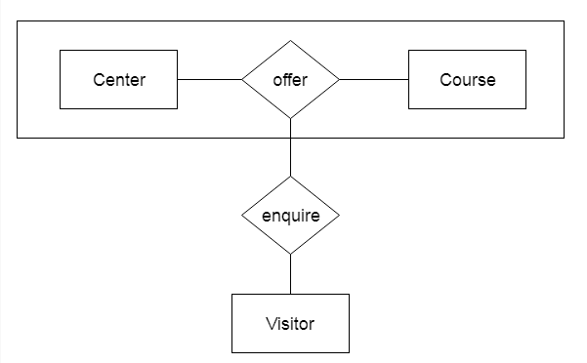
AGGREGATION IN DBMS
In aggregation, the relation between two entities is treated as a single entity. In aggregation, relationship with its corresponding entities is aggregated into a higher level entity.
For example: Center entity offers the Course entity act as a single entity in the relationship which is in a relationship with another entity visitor. In the real world, if a visitor visits a coaching center then he will never enquiry about the Course only or just about the Center instead he will ask the enquiry about both.
When it comes to statistical information in a DBMS,
there are extraordinary gears and approaches to collect it.
SUM: It is used for adding things up.
AVG: It is used for finding the middle ground.
Minimum (MIN): It is used to get the singling out of the smallest values.
Maximum (MAX): It is used for singling out for the largest values.
COUNT: It is used for a headcount and DISTINCT for counting unique items.

